Slide 1
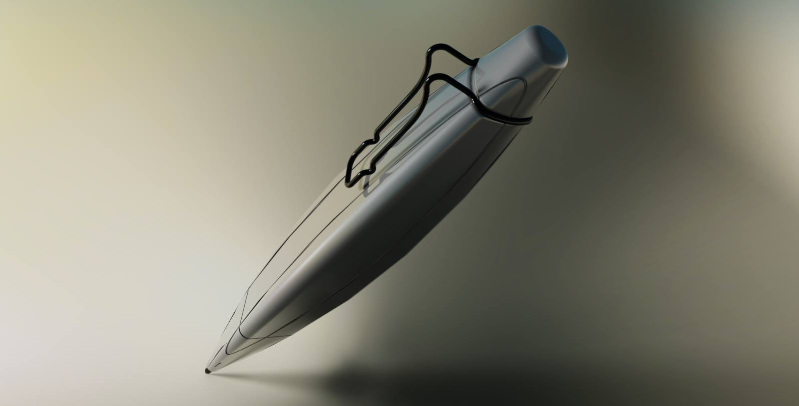
Lesion 6 Advance Loft and sweep
LAB 05 (weird Pen)
IDE 33101CAID Dr. Palang WONGTANASUPORN lecture 8-9
Weird Pen
Step by step
reveal

Slide 2
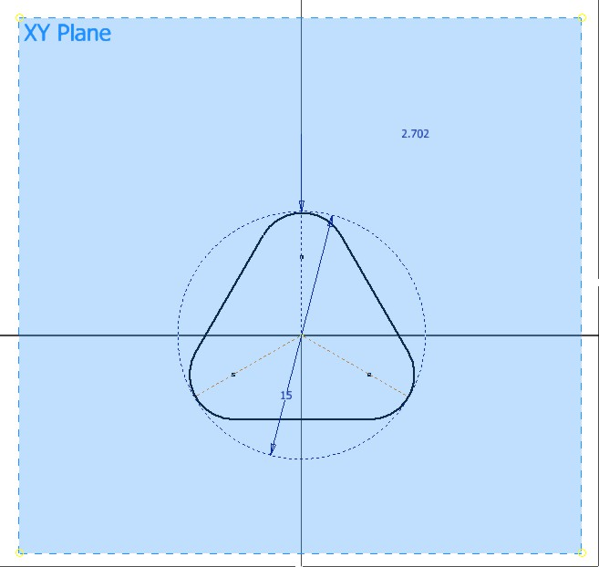
Sketching profile
Select XY plane as the sketch plane
Create a round corner triangle as the picture shows
Make sure that center of triangle is located on the center of XY plane

Slide 3
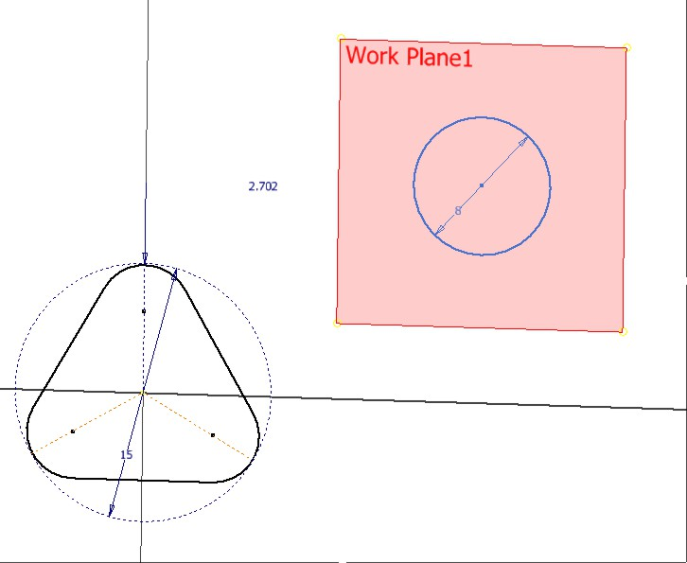
Create other work plane
2 more work plane are need for profile of bottom end and top tip of the pen
Work plane 1 for bottom end is located -120 mm alone Z axis
Work plane 2 for Top tip is located 20 mm alone Z axis
Sketch profile of bottom end and top tip
Make sure those center of these 3 profiles have same location on XY plane

Slide 4
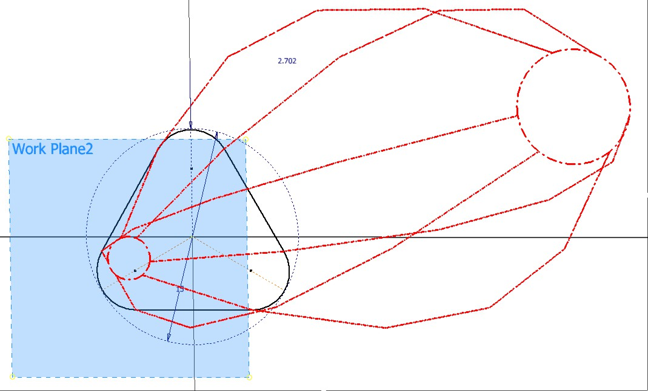
Loft operation
Start loft operation
Select profile as sketch from top to end
Click Ok to create new loft model

Slide 5
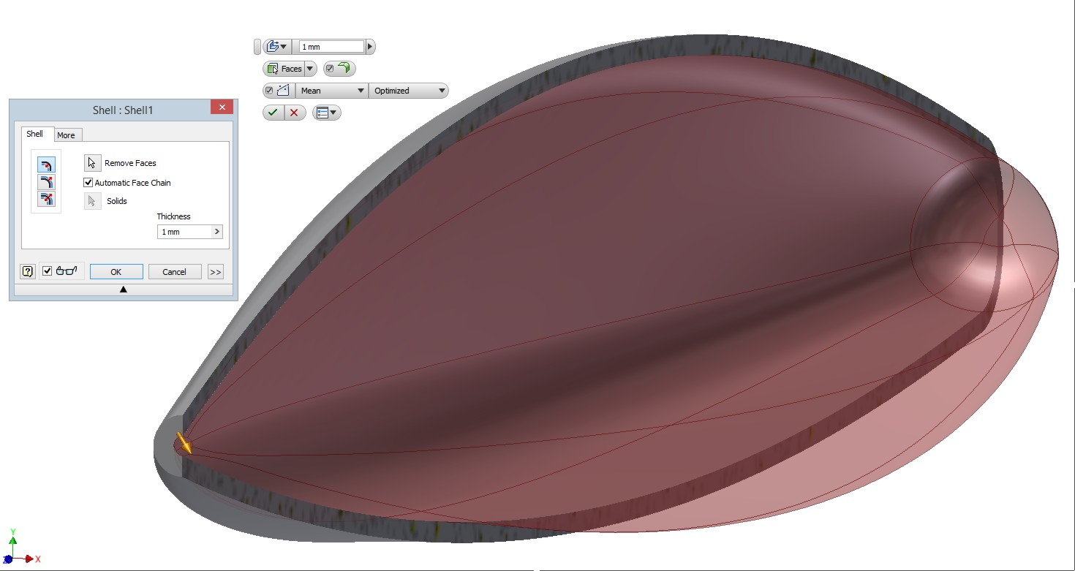
Shell Operation
Input thickness of model
Select faces for shell
Select the top tip face for remove faces
Click OK, model will get hollow inside
Thickness of face will create from outside to inside

Slide 6
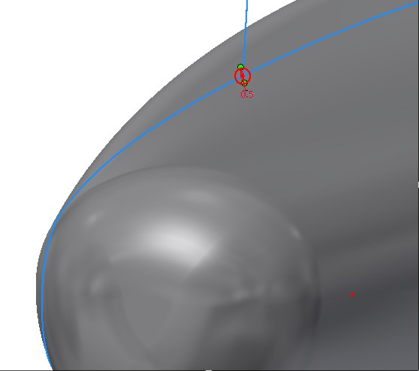
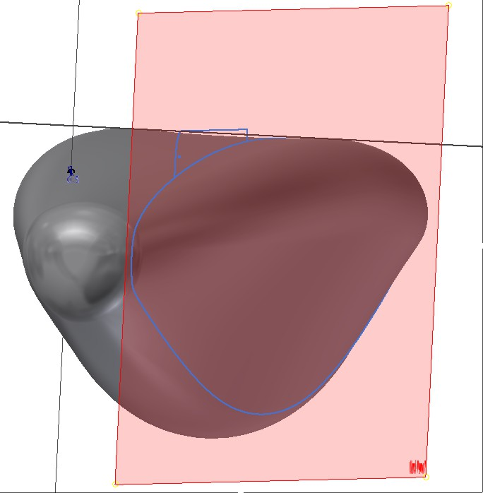
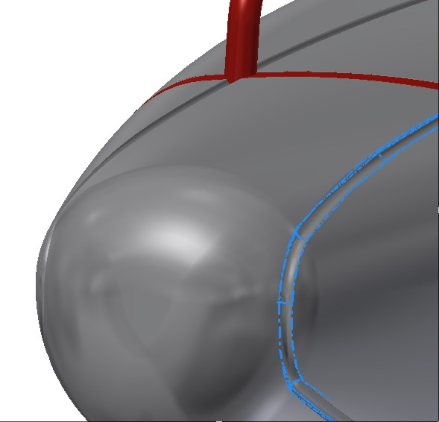
Sweep cut grip
Before Cutting grip you have to create a new plane for sketching path and a profile for remove material from faces
Create new work plane that offsets 8 mm from YZ plane
Click at command sketch then operate Project Geometry → Project Cut Edges
Now you have a new profile sketch on work plane 3
On XY plane create a cutting profile
Operate sweep operation then select a cutting profile and use sketch on work plane 3 as path
Click OK

Slide 7
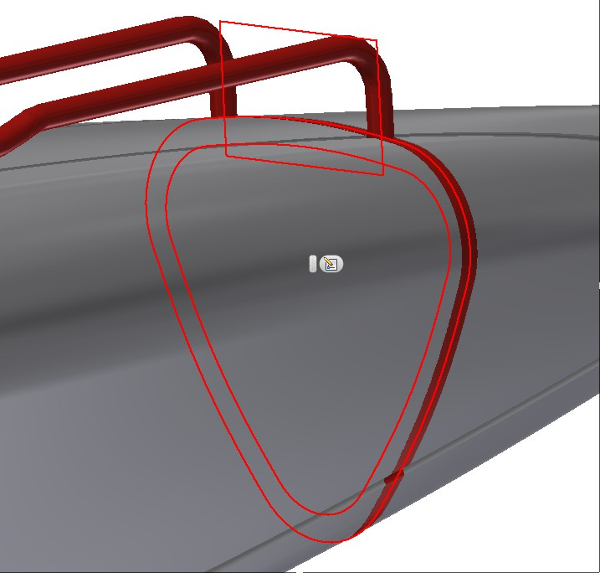
Cutting washer
Create a Work plane by offset it from XY plane along the location of washer
Create a circle plate that its diameter bigger than pen body then extrude a new solid
Use Combine Operation to intersect a new solid and Pen body
Do not forget to tick on KEEP Tool Body function

Slide 8
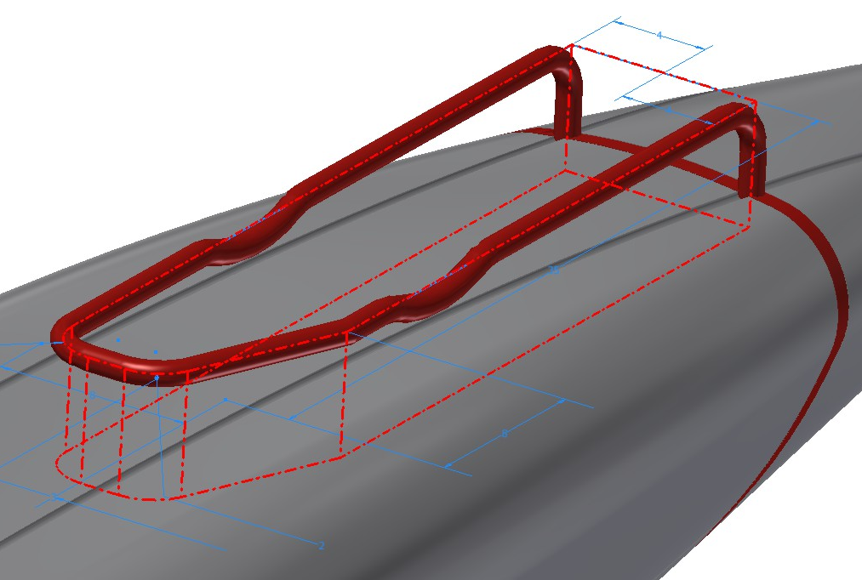
Making pen-clip
Create a work plane then sketch profile of pen-clip
Extrude and redefine shape of pen-clip
Use Project Geometry to trace line for sweep
Create cross-section
profile then sweep as new solid

Slide 9
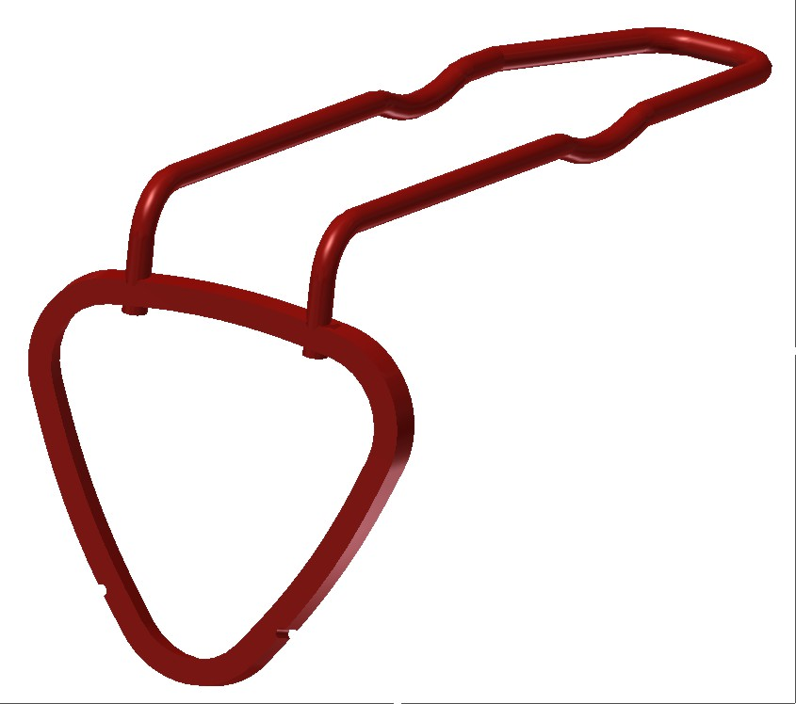
Combine Washer and grip
Use combine operation to divide the hole pen body by using washer as partition
Combine washer and pen-clip
Decorate the whole wired pen by changing material

